Slide 1

American Airlines Challenge
HackTX 2018
Arsalan | Austin | Jie | Shashank

Slide 2
Vacation Planner
Realize your vacations. Fast
With flights going from anywhere to everywhere in these times, deciding a vacation destination has become a nightmarish task. Deciding on a destination has started taking more time than the actual vacation. Our product aims to reduce this mental load on the user, and present him with travel plans curated to his needs, that makes trip selection a child’s play, and the actual trips more worthwhile.

Slide 3



CONCEPTS
Intuitive
Usable, Desirable, Findable
Consistency
Don’t make me think
Personalized Suggestions
Real-time itinerary

Slide 4
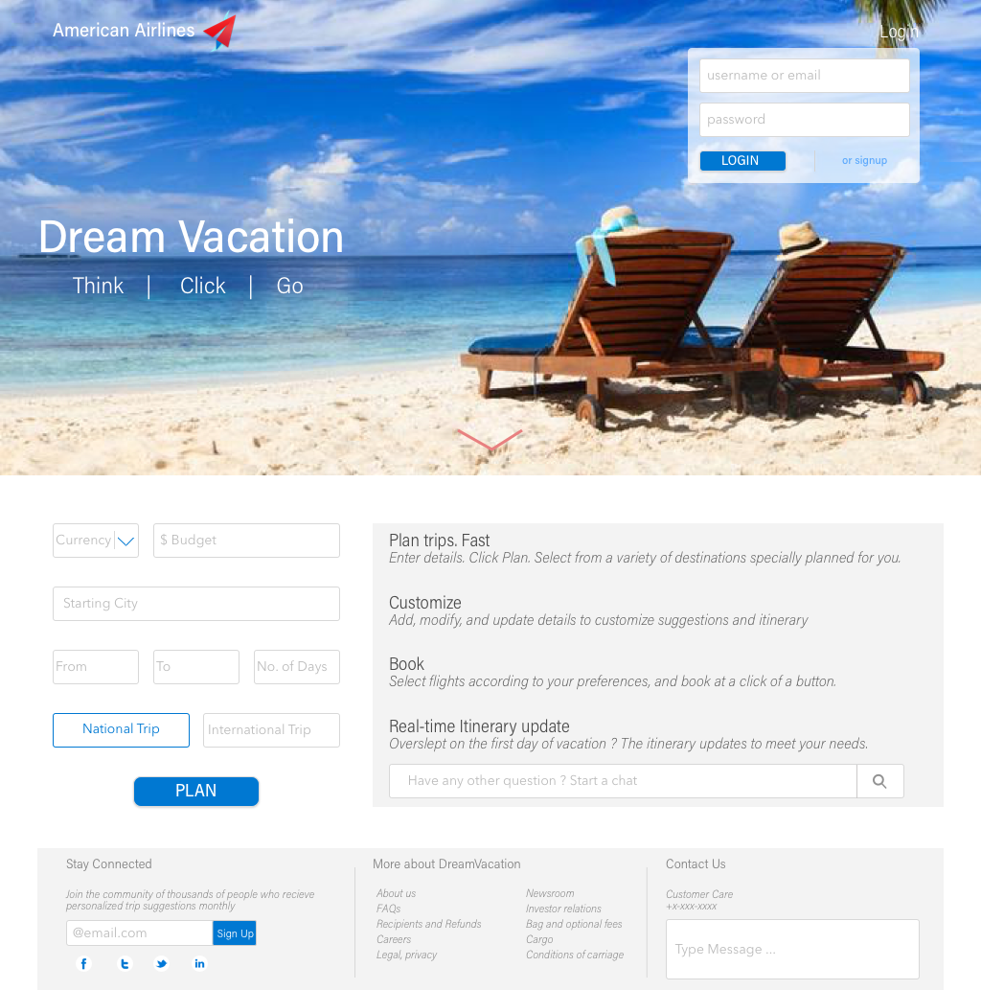
Step 1
User Inputs
Budget
Departure City
Dates
International/National Trip
Login Option
Dashboard
Instructions
Query
Footer
Stay Connected
More about Us
Contact
Step 2
Step 3
Step 4
Step 5

Slide 5
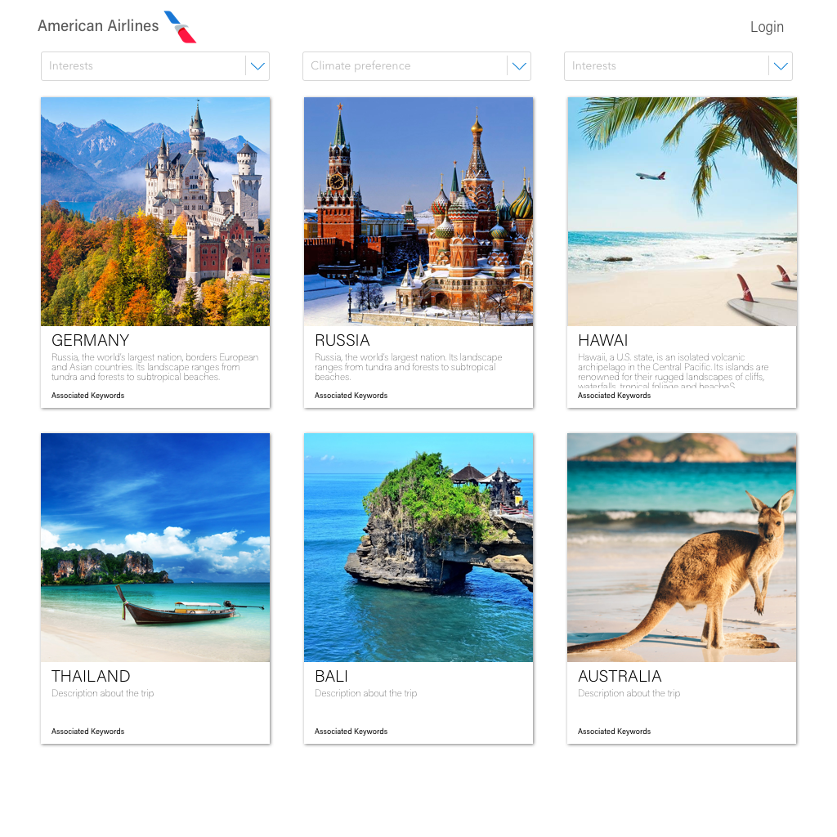
Step 1
User Inputs
Step 2
Suggestion Tiles
Based on user input, trip tiles are presented with brief information.
Tiles contain
Images
Description
Associated Keywords
Filter
User can change his interests to filter tiles as he searches. Filters include
Interests
Climate
Step 3
Step 4
Step 5

Slide 6
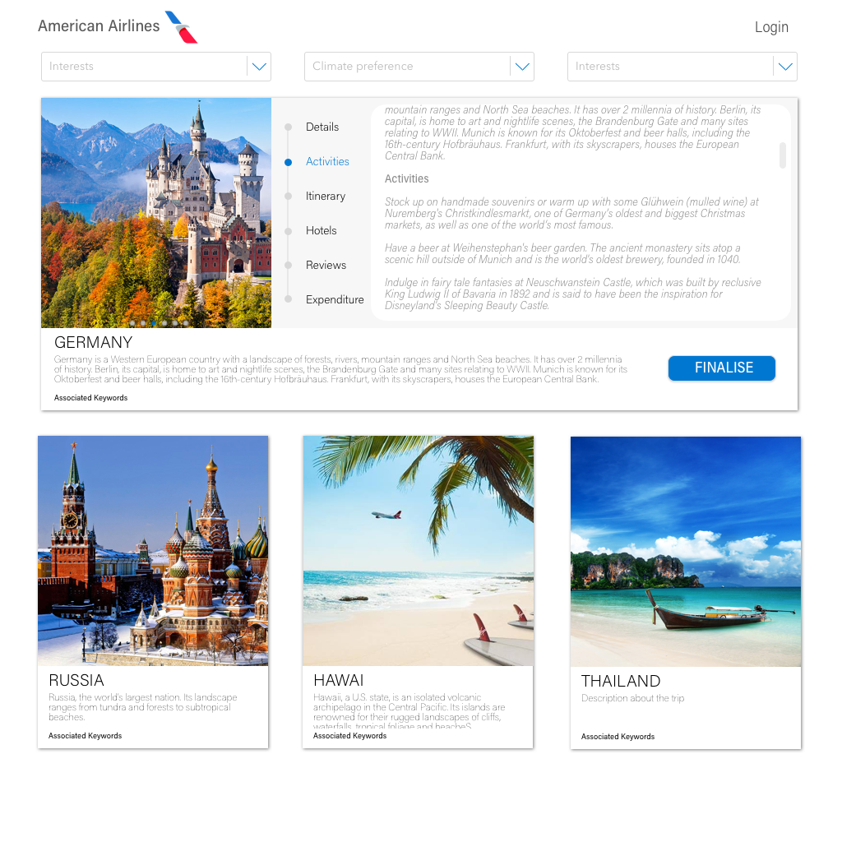
Step 1
User Inputs
Step 2
Suggestion Tiles
Step 3
Suggestion Tiles
Tiles, on selection, expand to give information on :
Activities
Short Itinerary
Hotels
Reviews
Expenditure
Filter
Interests
Climate
Step 4
Step 5

Slide 7
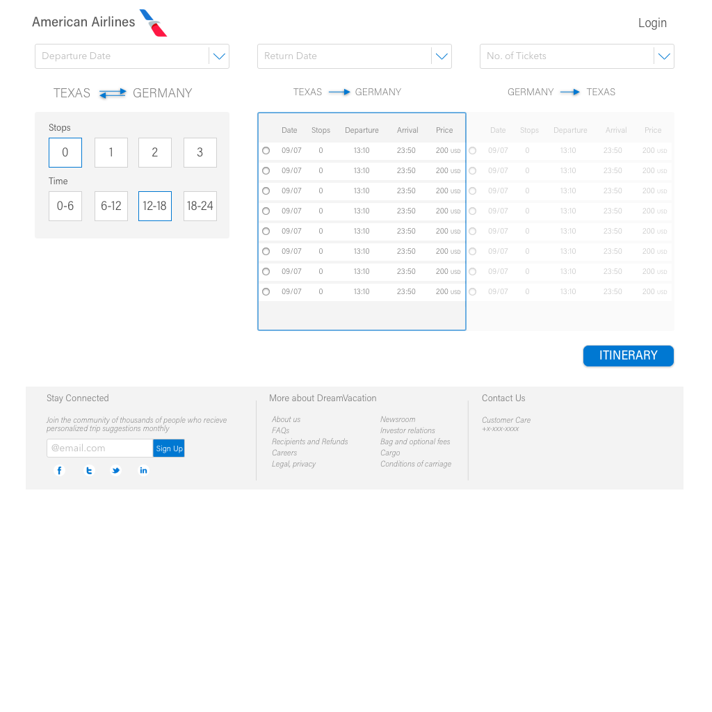
Step 1
User Inputs
Step 2
Suggestion Tiles
Step 3
Suggestion Tiles
Step 4
On selection of a destination,
User is presented with multiple flight options around his initially selected dates for flexible selection
Filters
Departure Date
Return Date
No. of Flight stops
Flight Time
Step 5

Slide 8
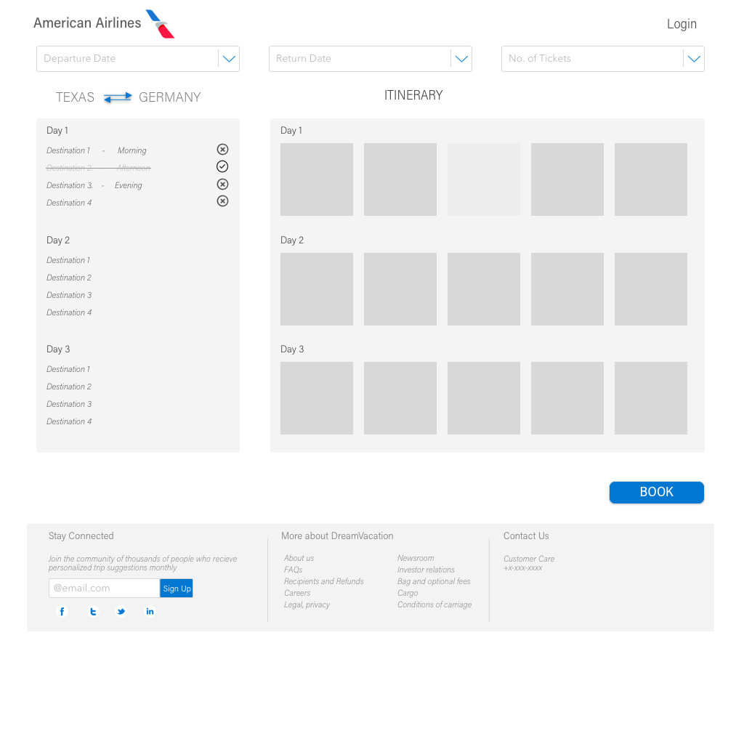
Step 1
User Inputs
Step 2
Suggestion Tiles
Step 3
Suggestion Tiles
Step 4
Final Flight Confirmation
Step 5
Custom made itinerary for the user, which he/she can modify as per preference. Once finalized, user can click “BOOK” to confirm tickets
Step 6
Press BOOK
and you are all set

Slide 9
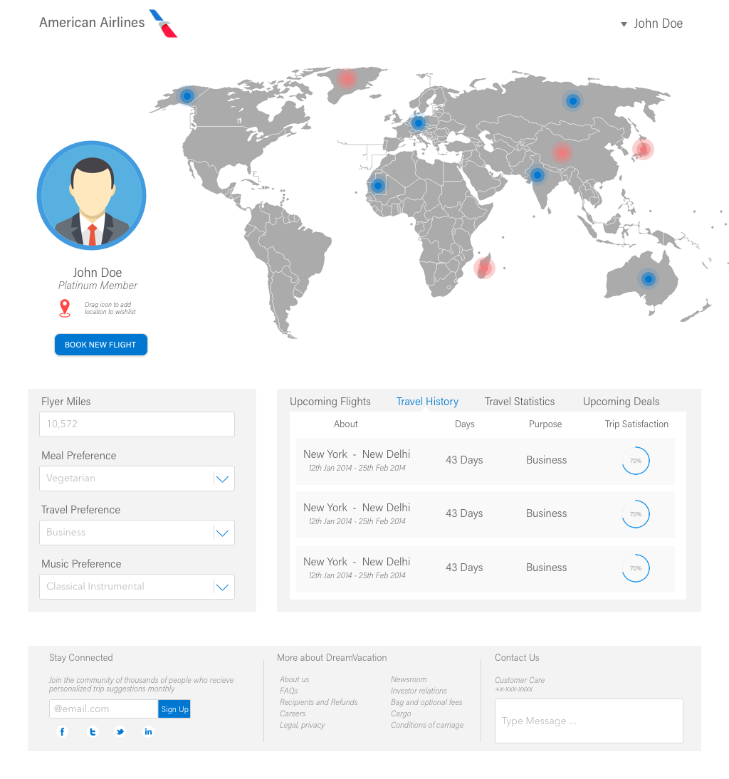
Landing Page
Dashboard
World Map
Graphically represents user’s visited places (in blue dots) and user’s wishlisted places (in red dots).
Upcoming Flights
Travel History
Travel Statistics
Deals
General User Data
Flyer Miles
Meal Preference
Travel Preference
Music Preference
Book
Flight
Account
Info
Log
Out

